Slide 1


Full Stack-Web Development - CSS

Slide 2

CSS Intro
3 Ways of Declaration
Inline -> As style attribute
Internal -> As style tag
External -> As separate file
Inline css : property
key : value pair is used.
e.g color:violet, border:2px solid red

Slide 3
CSS Intro
Internal css
made with tag inside head tag
p{
key:value;
}
eg. backgroud-color: aquamarine;
text-decoration:underline;

Slide 4
CSS Intro
External css
New file made with link inside head tag
Tag : link
Attribute: rel-> relation
p{
key:value;
}
eg. backgroud-color: cornflower;
text-decoration:line-through;

Slide 5
CSS Intro
I
Specificity
Inline>Internal>External
Selectors
Basic Selectors
Advance Selectors

Slide 6
I
Basic Selectors (categorize to 5 types)
Element selectors (eg. p,div,h1)
Id Selectors (eg. Id=“name” ->
#name{
background-color:purple;
}
Note: Do not repeat id name

Slide 7
I
Basic Selectors (categorize to 5 types)
iii. Class Selectors(eg. Class=“className”->
.className{
border:2px solid orange;
}
Note: We can repeat class names

Slide 8
I
iv. Attribute Selectors
eg.href=“www.google.com”->
a[href=“www.google.com”]{
font-size:200px;
}
eg. <input type=“text”>->
input[type=“text”]{
border:2px dashed red;
}

Slide 9
I
Universal Selector
*{
border:2px solid yellow;
}
Note: It selects everything
Specificity:
Inline>id>class>element

Slide 10
I
Advance Selectors (categorize to 4 types)
Combinators
Pseudo Classes
Structural Pseudo classes
String Matching

Slide 11
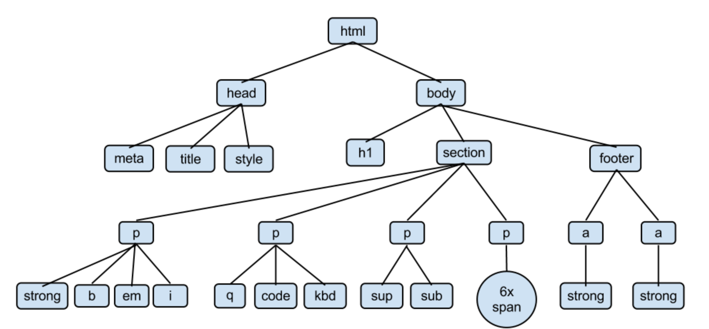
I
HTML is the root element
Here,
->p tags are the descendent of
Body.
->And sibling among themselves.
->strong,b,em are also descendants
of body.
->strong,code,sup,sub are general
siblings.

Slide 12
I
Advance Selectors
Combinators : Combination of 2 things
i. Descendants
-> a ‘space’ in between them means a descendent.
-> it works on any level.
ii. Child
-> we have to use ‘>’ to denote child selector.
-> it do not work on all level.

Slide 13
I
Combinators
iii. Adjacent Sibling
-> it is denoted via ‘+’
-> only one tag is selected that comes after element.
iv. General Sibling
-> it is denoted via ‘~’(Tilde)
-> all the tag is selected that comes after element.

Slide 14
I
Advance Selectors
Pseudo Classes
:hover
:active
:visited
:nth of the type(odd,even)
:first-child,:last-child
:focus

Slide 15
I
nth of the type
:nth-of-type(an+b)
an+b->offset
an-> intervals
b-> starting index

Slide 16
Pseudo Elements
A CSS pseudo-element is used to style specified parts of an element.
-> It doesn’t work on inline elements.
p::first-letter
p::first-line
::after (don’t affect inline elements)
::before
Css-property : content: ‘\1F4F1’

Slide 17
String Matching
1.Starts with : ^=
Eg. a[href ^= “https”]
2.Ends with : $=
Eg. a[href $= “com”]
3.Present anywhere : *=
Eg. a[href *= “google”]

Slide 18
Inheritance
Child adapt properties of parents.
Works on : color, font-size
Doesn’t works on : border, background-color

